Slide 1
Iqra Hardianto Nurichsan
Program data science
Job connector
Back ground:
Forestry Engineering ITB
Surveyor Ekspedisi Papua Terang PT. PLN
Freelance : Surveyor, Mapping, Drone pilot
Owner Sate Kompeni

Slide 2

Problem
THE BENEFITS OF E-COMMERCE:
We Have Lots of Data,
but it to saturated
To make any kind of strategy
Business using this data

Slide 3
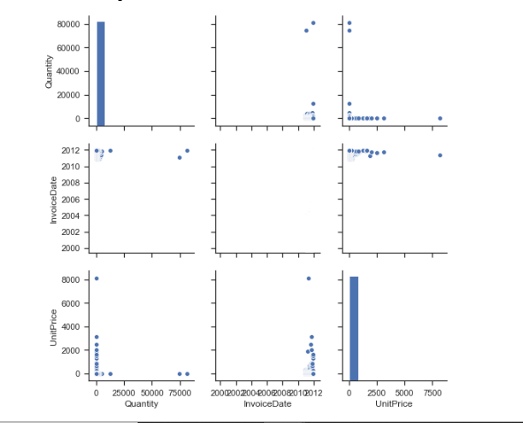
DATA IS MESSY

Slide 4

GOAL
Simplify thing and group them
Into specific group
Know more about our customers
And later on we can make a more accurate strategy using this data based on groups that we have analyze

Slide 5
HOW?
Using RFM (RECENCY, FREQUENCY, MONITARY)
RECENCY = how active our customer
FREQUENCY = how frequent our customers make purchases
MONITARY = how much revenue do they produce for the company

Slide 6
RFM
Making our data ready:
RECENCY = (max last purchase date + 1day) – (last time customers purchased)
FREQUENCY = unique purchases (we can see it buy summing up invoices/ customer)
MONITARY = quantitu * unit price

Slide 7
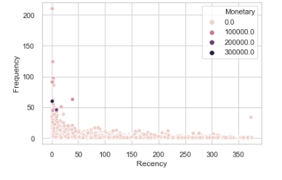
Problem

Slide 8
Using machine learning to group
The best machine learning so far that I have found is k means with scaled data (standard scaler)
And labeling it based on there RFM streangth and weakness

Slide 9
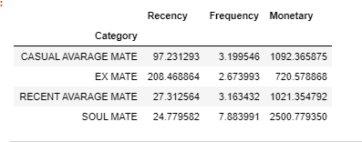
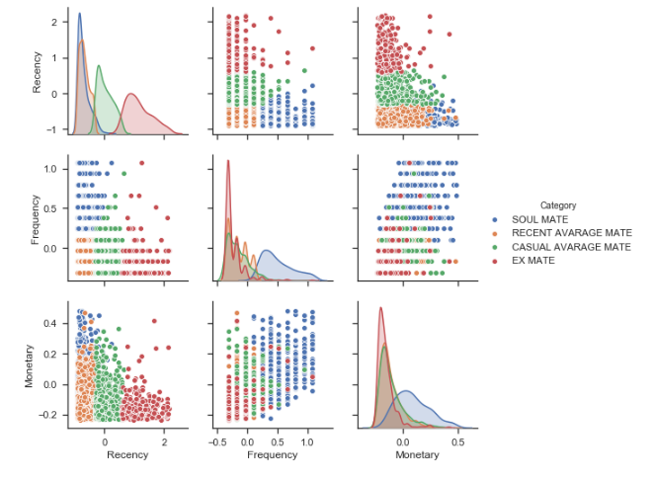
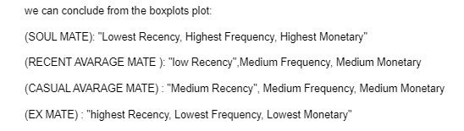
RESULT

